Slide 1
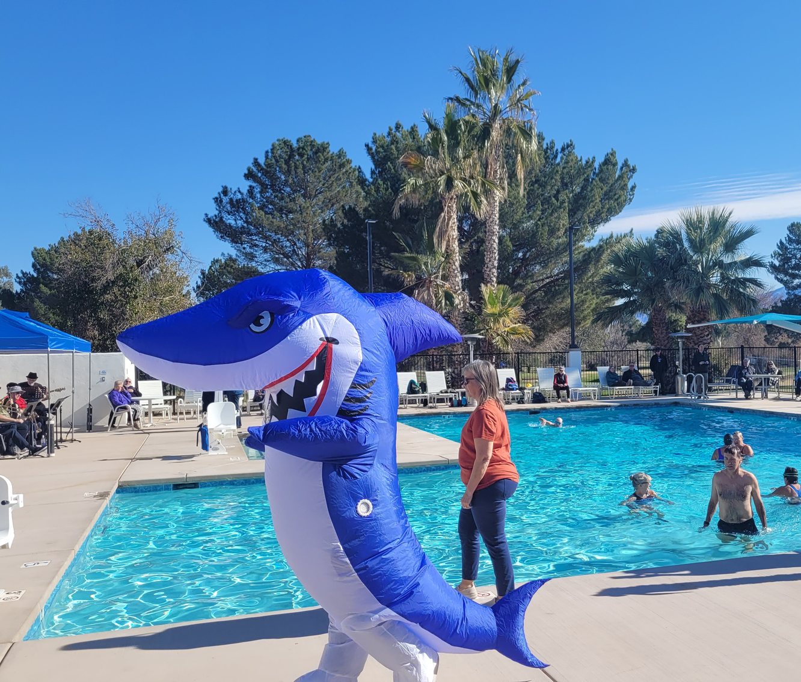
2022
Providing excellent facilities and services that create opportunities for recreation, social activities, and leisure education to enhance the quality of our members’ lives.
YEAR IN REVIEW
Annual Meeting
2023

Slide 2
13,640
Member Households
22,323
Individual Members

Slide 3
By the Decade
04
1910s babies
1920s babies
1930s babies
1940s babies
1950s babies
1960s babies
1970s babies
11
327
2,684
8,475
6,506
1,759
268
Most popular birth year: 1948
Members listed on deeds whose birth dates are known

Slide 4
1,440
Guest Passes Issued
1,250
Tenant Passes Issued
74
LifeCare Member Passes Issued

Slide 5
Projects
Underway
Complete
East Center Pool
Computer Club relocation
Arts and Crafts room relocation
Del Sol Clubhouse
Desert Hills Fitness

Slide 6
Projects
Underway
Complete
Member survey
New website
Drop-in room use
Aid stations
Landscape renovations

Slide 7
Survey Says...
75%
Satisfaction with GVR services and programs.
Satisfaction with GVR staff
73%

Slide 8
Survey Says...
79%
Agree GVR provides excellent facilities
Agree GVR offers good or excellent value for money
64%

Slide 9
Survey Says...
Top Three Member Priorities
1
Pursue greater efficiency
2
Complete capital projects and
facility improvements
3
Continue to improve Board functionality, professionalism and productivity

Slide 10
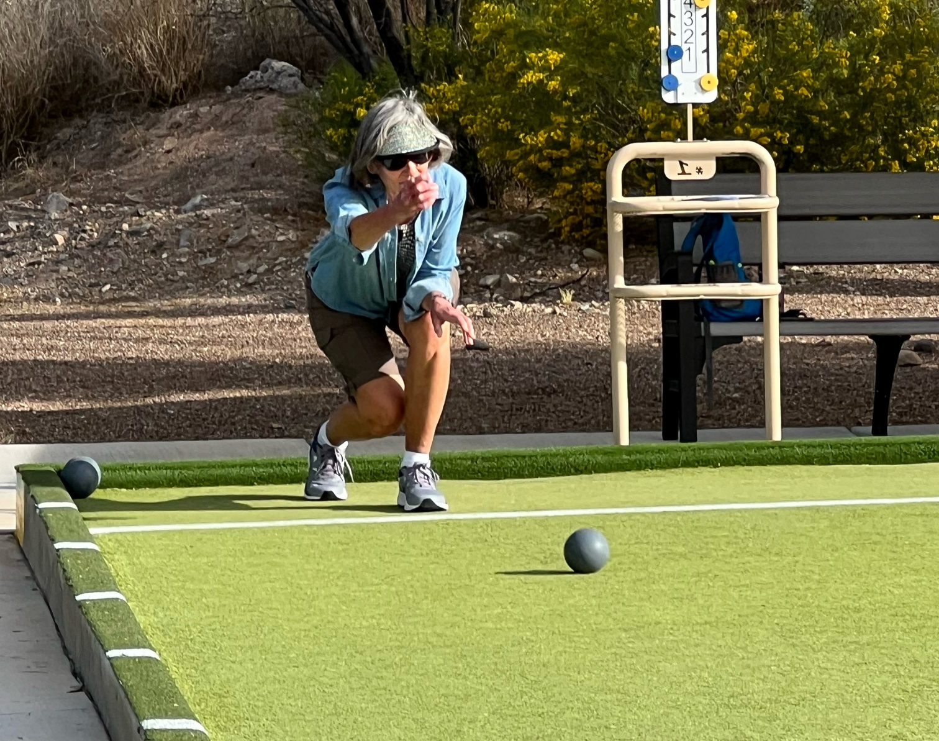
RECREATION

Slide 11
Fitness Coordinator Hired
Underway
Complete
Resume fitness orientations
Expand personal training
Reduce equipment repair time

Slide 12
21
Performances
supported by
102
A&E Volunteers

Slide 13
10
Sold-out dances
Jukebox Junquies
Uncorked
Hardscrabble Road Band
Sonorous
No Sand Beach Band

Slide 14
Courses offered
599
Enrollments
5,163
70
Courses full
43
Courses with wait lists

Slide 15
Most enrollments
1
Line Dance 1 (39)
2
Arizona's Cacti (35)
3
Beyond the Field Guide: Owls (35)

Slide 16
Clubs
61
Two new (Canine & Martial Arts) and three dissolved (Argentine Tango, LGBTQ, Midweek Progressive Bridge)
9,113
Club Members

Slide 17
14
Sports Clubs
2,658 members
12
Arts and Crafts Clubs
1,614 members
10
Social Clubs
1,232 members

Slide 18
15
Cards and Games Clubs
1,062 members
7
Special Interest Clubs
1,894 members

Slide 19
Making it All Happen

Slide 20
12
Board Members
36
Committee Members

Slide 21
67
Full Time Staff
35
Part Time Staff
As of 12.31.22

Slide 22
Looking Forward...
Glass Arts Studio
2023
A New Website
Clubhouse Improvements
Planning for the expansion of Lapidary, Ceramics, Woodshop, Metal

Slide 23
Looking Forward...
Improving Center Security
Evaluating expansion of LC & SRS fitness centers
New classes and a fresh approach to trips & tours
2023

